Slide 1
A fast algorithm for the generalized k-keyword proximity problem given keyword offsets
Sung-Ryul Kim, Inbok Lee, Kunsoo Park
Information Processing Letters,
vol. 91, pp.115–120, 2004

Slide 2
Abstract
When searching for information on the Web, it is
often necessary to use one of the available search
engines. Because the number of results are quite large
for most queries, we need some measure of relevance
with respect to the query. One of the most important
relevance factors is the proximity score, i.e., how close
the keywords appear together in a given document.

Slide 3
Abstract
A basic proximity score is given by the size of the
smallest range containing all the keywords in the query.
We generalize the proximity score to include many
practically important cases and present an O(n log k)-
time algorithm for the generalized problem, where k is
the number of keywords and n is the number of
occurrences of the keywords in a document.

Slide 4
Proximity score
Used when given multiple keywords
If proximity is good
  Likely that the keywords occur in a paragraph or a sentence
Cannot be computed off-line
  Just too many possible combinations
  Computation must be very efficient

Slide 5
How to store docs. in web search databases
Typical search
  A few keywords, look for documents with all the keywords
  Not efficient to store a document as is
Typical scheme
  Inverted file
    List of document IDs for each keyword
    Each document ID has a list of offsets
      For each occurrence of the keyword
      Counted in words

Slide 6
Example – one document ID
I am Tom. You are Jane.
I am a boy. You are a girl.
I am a student. You are a
dropout. ….
….
….
….
i
0, 6, 14, …
am
1, 7, 15, …
tom
2, …
you
3, 10, 18 …
are
4, 11, 19
jane
5, …
….
…

Slide 7


Terminology
Range
  Is a continuous area in a document
  is inclusive and denoted by
Size of range
  The size of range is

Slide 8

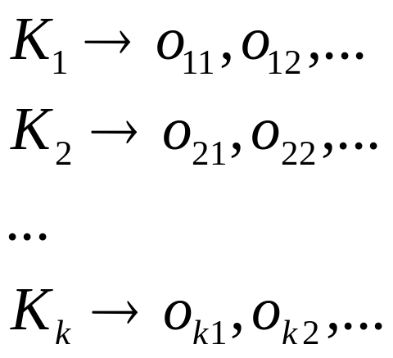
The basic proximity problem
Given keywords and lists of offsets
Find the smallest range in the document where all the keywords appear

Slide 9
Extension #1
Not all of the keywords
  ‘apple computer support’
    All results may have bad proximity score
    Some good score with ‘apple’ and ‘computer’
    proximity score with partial keyword

Slide 10
Extension #2
Multiple occurrences of keywords
  ‘johnson and johnson’
  ‘johnson’ must appear at least twice
  proximity requiring repetitions of keywords

Slide 11

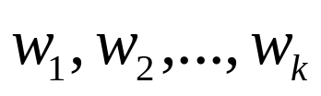




Def. of Generalized Prob.
Input
  keywords:
  Lists of offsets:
  Thresholds:
  # keywords in range:
Solution
  The smallest range containing at least keywords
  Each keyword more than threshold times

Slide 12

Previous works
Gonnet et al.
  Two keywords within a given distance
Baeza-Yates and Cunto
  Logarithmic time alg. with square time construction
Manber and Baeza-Yates
  Logarithmic time alg.
    Given distance
    Superlinear space
Sadakane and Imai
  Basic proximity problem
  time

Slide 13
Our result
Generalized problem
time

Slide 14




The algorithm
Merge phase
  In time
Scan phase
  In time
There can be multiple scans
  With scans with different thresholds and
  In time

Slide 15

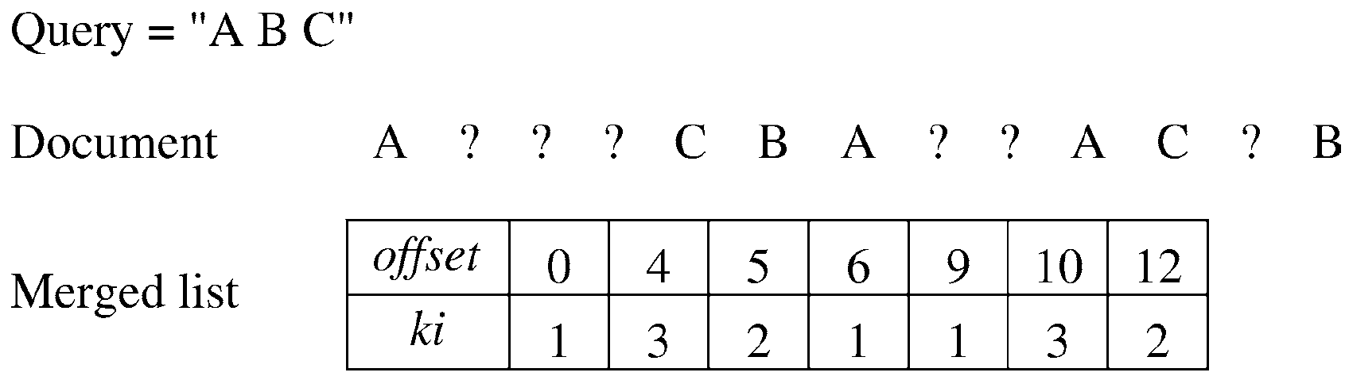
The merge
The input lists are merged
  The merged list is denoted by L[0 . . .n − 1].
  two fields L[x].offset and L[x].k_{i}
  Takes time

Slide 16
Candidate range
Def. Candidate range is a range that matches the problem definition
  The solution is a candidate range
  The number of candidate ranges is less than n×(n − 1)/ 2

Slide 17
Critical range
Def. Critical range is a candidate range that does not properly contain other candidate ranges
  Lemma. The solution is a critical range.
    The solution is a candidate range
    If the solution is not a critical range, then smaller ranges that match problem definition exist.

Slide 18
# critical ranges
  Lemma. Critical ranges are not nested
    Immediate from the definition of critical ranges
  Lemma. There are linear number of critical ranges
    Critical ranges do not share left ends
      Nested if so
    Only linear number of possible left ends

Slide 19
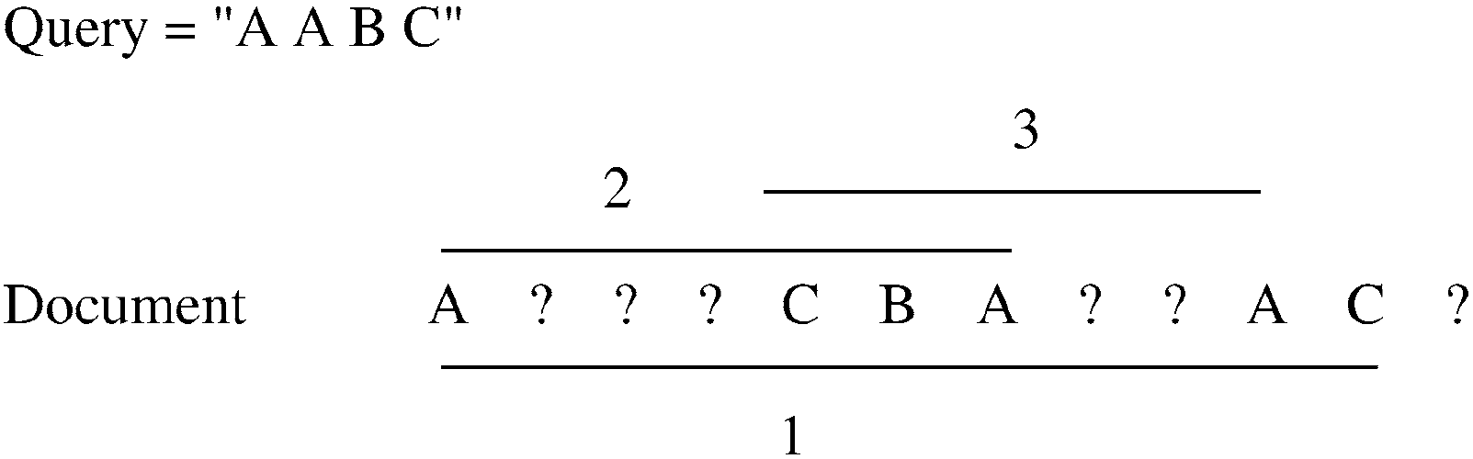
Difference between critical ranges and candidate ranges

Slide 20
Scan critical ranges in linear time
Variables used
  Current left end pointer - L
  Current right end pointer – R
    (L, R) is the current range
  Counters for each keyword - c_{i}
    # occurrences in the current range
  Threshold counter - h
    # keywords over the threshold

Slide 21
Updating the counters
The counter for each keyword
  Updated each time L or R is moved (by one)
  Reflects the # occurrences of each keyword in the range
  Only one counter is affected per move
At each move
  Check if the current range is a candidate
  To avoid looking at all counters
    Threshold counter has # counters over the threshold

Slide 22



The first critical range
Repeatedly move the right pointer R until the current range is a candidate range
  The right end pointer has the end point of the first critical range
  No range of the form is a candidate range if
Repeatedly move the left pointer L until the current range is not a candidate range
  Move L back by one and you have the first critical range

Slide 23
Illustration
L
R
↓
↓
Critical ranges

Slide 24
Illustration
L
↓
R
↓
Critical ranges

Slide 25
Illustration
L
R
↓
↓
Critical ranges

Slide 26
Illustration
L
R
↓
↓
Critical ranges

Slide 27
The next critical range
Move L to the right by one place
Repeat as if looking for the first

Slide 28
Time complexity - scan
Each movement of pointers takes constant time
  Two variables are updated for each movement
    Counter for affected keyword
    Threshold counter
The scan finishes in linear time
O(n)

Slide 29

Conclusions
Linear time algorithm if
  # keywords k is a constant,
  merged form is given,
  or working on the original document
Is optimal?

